Slide 1
Plasma concentration of injectable contraceptive correlates with reduced cervicovaginal mucosal growth factor expression in South African women
Refilwe Phemelo Molatlhegi
Centre for the AIDS Programme of Research in South Africa (CAPRISA), Durban, South Africa
Department of Medical Microbiology, U of KwaZulu-Natal, Durban, South Africa
African Health Research Institute (AHRI), Durban, South Africa
Medical Microbiology and Infectious Diseases, U of Manitoba, Winnipeg, Manitoba, Canada
Institute of Infectious Disease and Molecular Medicine (IDM), U of Cape Town, Cape Town, South Africa

Slide 2
Conflict of interest
No conflicts to declare

Slide 3
Background
Inconsistent data on injectable contraception use and HIV risk may be due to inaccuracy of self-reported data, unknown timing of injection, and interactions with other mucosal transmission co-factors.
We quantified plasma concentrations of DMPA in women from the CAPRISA 004 study (n=664), providing an opportunity to measure dose-dependent associations between DMPA and mucosal immunology
DMPA levels were modelled as high, medium, low, and none, and correlated to a panel of 48 cytokines measured in cervicovaginal lavage (CVL)
Kinetics of DMPA decay in plasma following injection

Slide 4
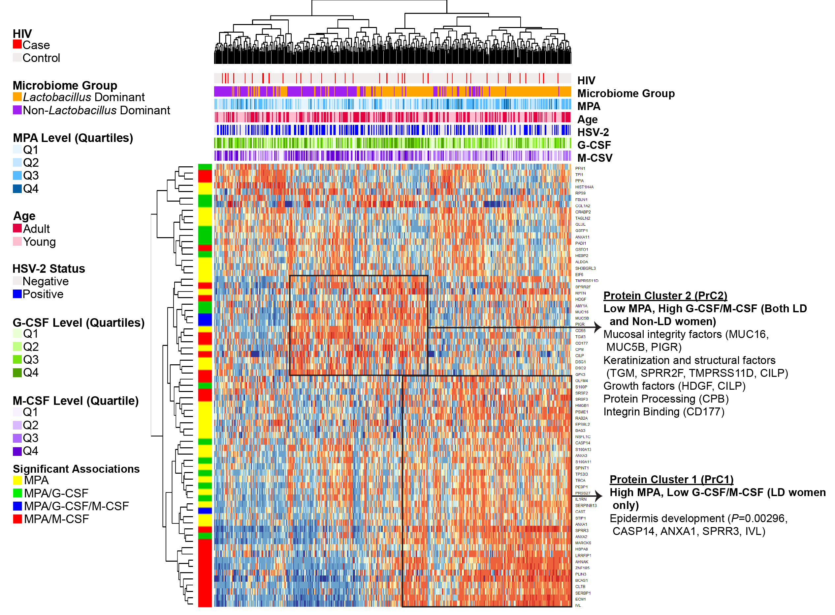
DMPA was associated with reduced growth factors (particularly G-CSF and M-CSF)
Pro-inflammatory Chemokines Growth factors Adaptive Anti-inflammatory
DMPA was not broadly inflammatory in our study population, even when at its highest levels.
Dose-dependent inverse association between DMPA and M-CSF/G-CSF significant after adjusting for: HSV-2, age, study arm, study site, number of sex acts per month, condom use and microbial grouping
Downregulation of these growth factors could be associated with impairment of the mucosal barrier
Low MPA/high G-CSF and M-CSF had higher levels of proteins important for mucosal fluid function, protein processing, integrin-binding, and factors involved in growth and keratinization

Slide 5
The biological effects of DMPA may vary depending on co-factors including age, HSV-2 status and vaginal microbiome composition.
Interaction p-values
p < 0.05 p > 0.05 and ≤ 0.1 p > 0.1 and ≤ 0.2
Stratification p-values
p < 0.05: *, p < 0.01: ** and p < 0.001: ***
Cytokines
Pro-inflammatory
Chemokines
Growth factors
Adaptive
Anti-inflammatory
Notes:
non-Lactobacillus-dominant group seemed to be more inflammatory due to observed elevation of four of the cytokines, IL-8, IL-7, IP-10, MCP-1 and IL-6 that have been previously been reported to be pro-inflammatory and associated with increased HIV risk

Slide 6
Acknowledgements
Co-authors: Lenine J. Liebenberg^{1,2}, Alasdair Leslie³, Laura Noel-Romas^{5,6}, Amanda Mabhula³, Nobuhle Mchunu¹, Michelle Perner^{5,6}, Kenzie Birse^{5,6}, Sinaye Ngcapu^{1,2}, John H. Adamson³, Katya Govender³, Nigel J. Garrett¹, Natasha Samsunder¹, Adam D. Burgener^{4,5,6,7}, Salim S. Abdool Karim^{1,8}, Quarraisha Abdool Karim^{1,8}, Jo-Ann S. Passmore^{1,9}, Lyle R. McKinnon^{1,5,6}
CAPRISA002 and 004 study participants, and the clinical and laboratory staff who worked on these studies.
Funding: Canadian Institutes of Health Research CIHR) (A.D.B., L.R.M. TMI 138658). R.P.M. was previously funded by the South African National Research Foundation (NRF) PhD Scholarship and University of KwaZulu-Natal College of Health Science (CHS) for PhD running expenses. L.J.L. is funded by a South African National Research Foundation (NRF) Research Career Advancement Fellowship award. L.R.M. and A.D.B are supported by a CIHR New Investigator Awards.
The CAPRISA 004 tenofovir gel trial was funded principally by the U.S. Agency for International Development, grants through FHI360, and CONRAD for product manufacturing, with support from the South African Department of Science and Technology (DST).

